Slide 1
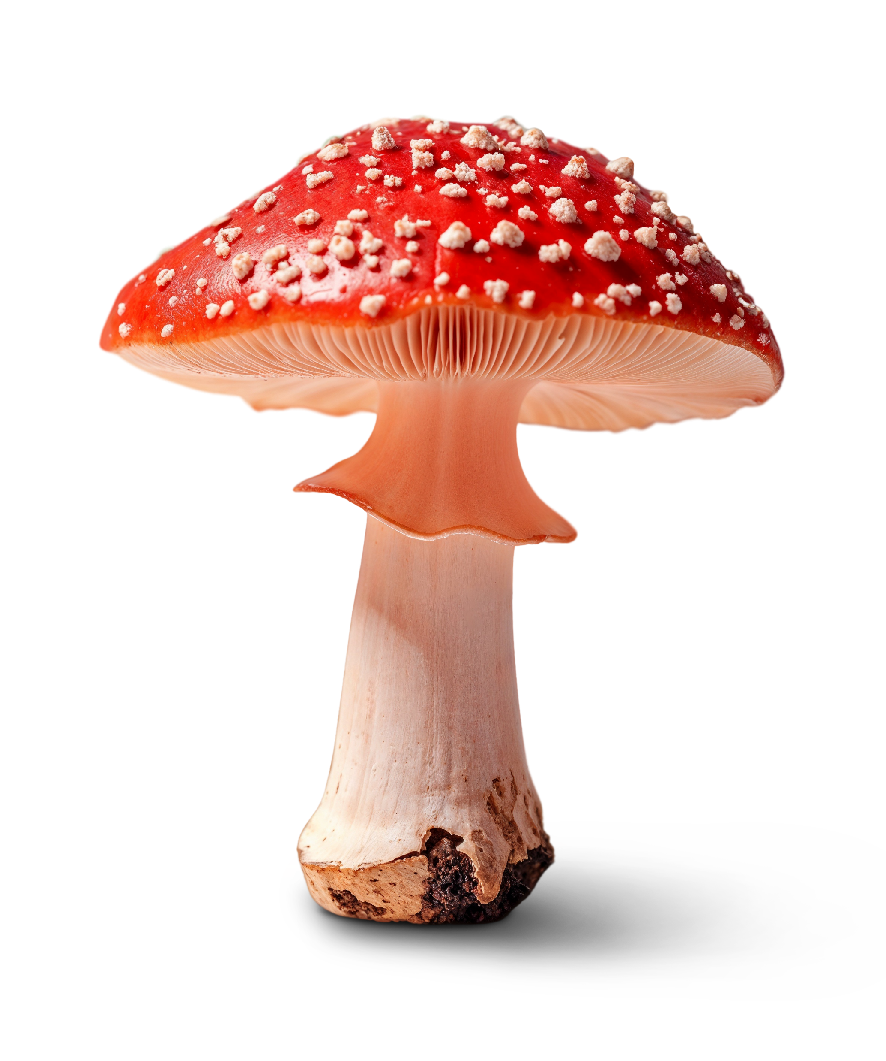
Edi-Fungi: Machine Learning Model to Safeguard Foragers by Distinguishing Poisonous from Edible Mushrooms
Tejas G K

Slide 2
Index
Problem Statement
Problem Approach
Dataset Information
Data Cleaning
Data Pre-processing and Feature Analysis
Data Modelling
Problem Statement:
The goal of this project is to develop a machine learning model that accurately predicts whether a mushroom is edible or poisonous.
It will use various features like cap shape, gill characteristics, stem dimensions, and spore print color to make this distinction.
The aim is to create a reliable tool to help people safely identify mushrooms, especially for foraging or related activities.

Slide 3
Data Cleaning
Data Duplicates
Null Value Treatment
EDA
Analysis of Target
Univariate, Bivariate Analysis of Features
Problem Approach
Data Transformation
Encoding of Target Column
Encoding of Features, Scaling Features
Data Modelling
Pipeline- Encoders, Scaling Classifiers, hyperparameters
Cross Validation, Performance Metrics

Slide 4
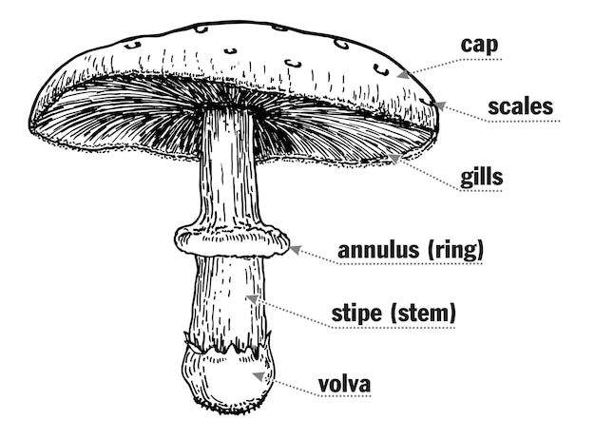
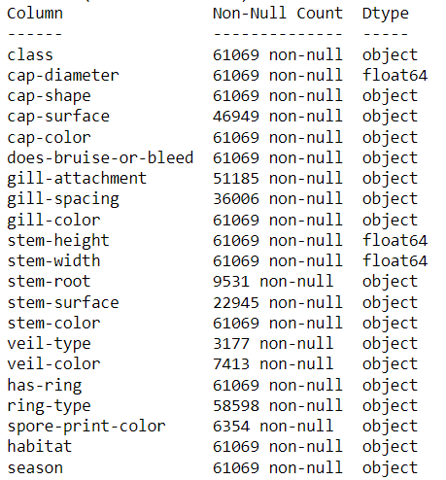
Data Information:
Rows- 61069
Columns -21
Data Cleaning: Removing Duplicates
Duplicates - 143
Total Row Count after removing duplicates - 60923

Slide 5
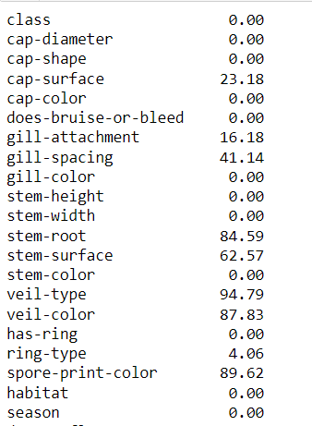
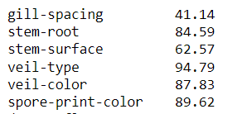
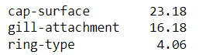
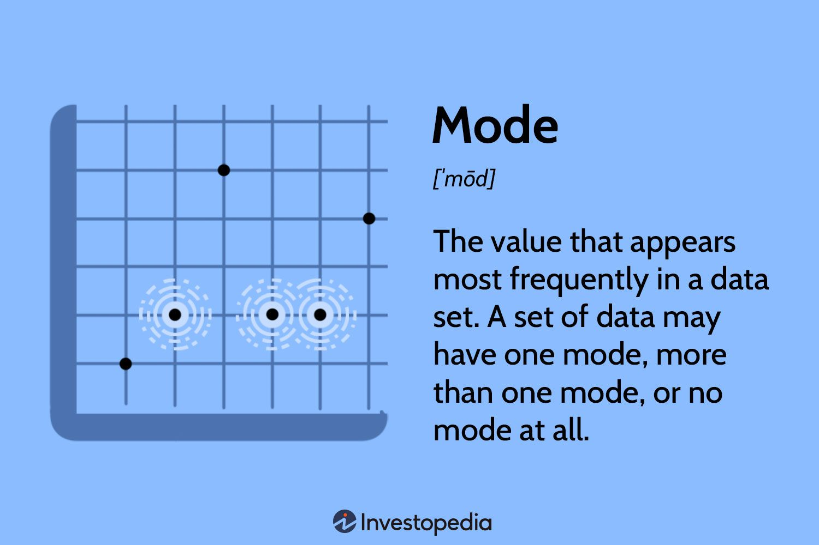
Data Cleaning: Null Values Treatment
Columns with Null Values
Columns with Null Values > 25%
Columns with Null Values < 25%
Treatment – Replace Null values with Mode As the Columns are Categorical
Treatment-Dropping the columns
Gill Spacing
Stem Root
Stem- Surface
Veil Type & Colour
Spore Print Colour

Slide 6
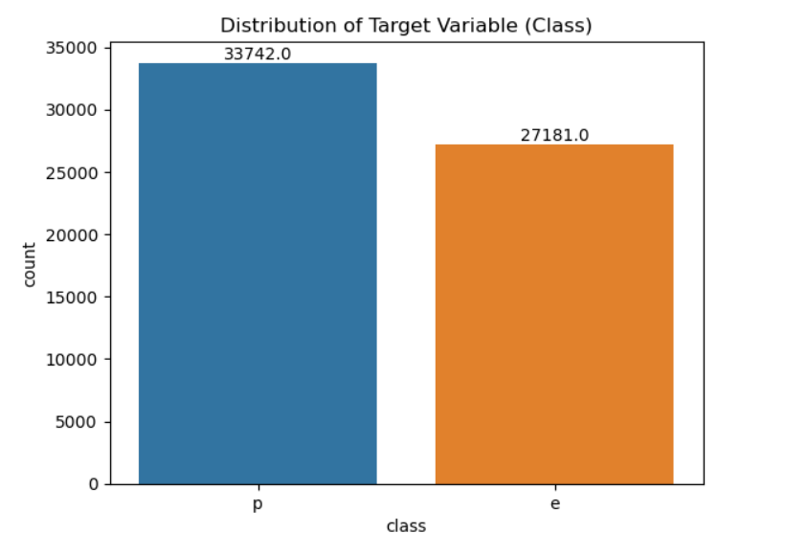
EDA – Target Column Analysis
Inference:
Target Columns classes are approximately balanced

Slide 7
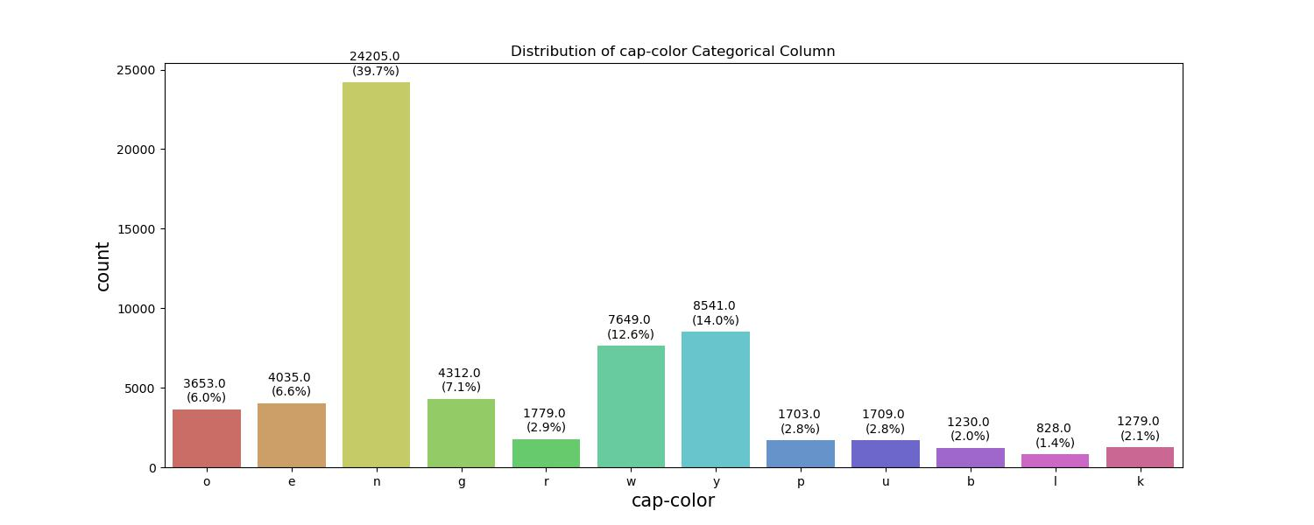
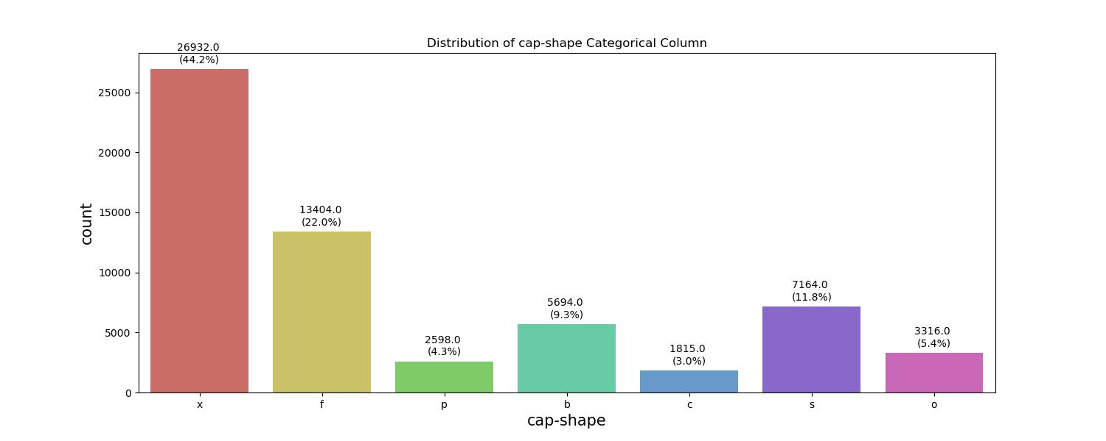
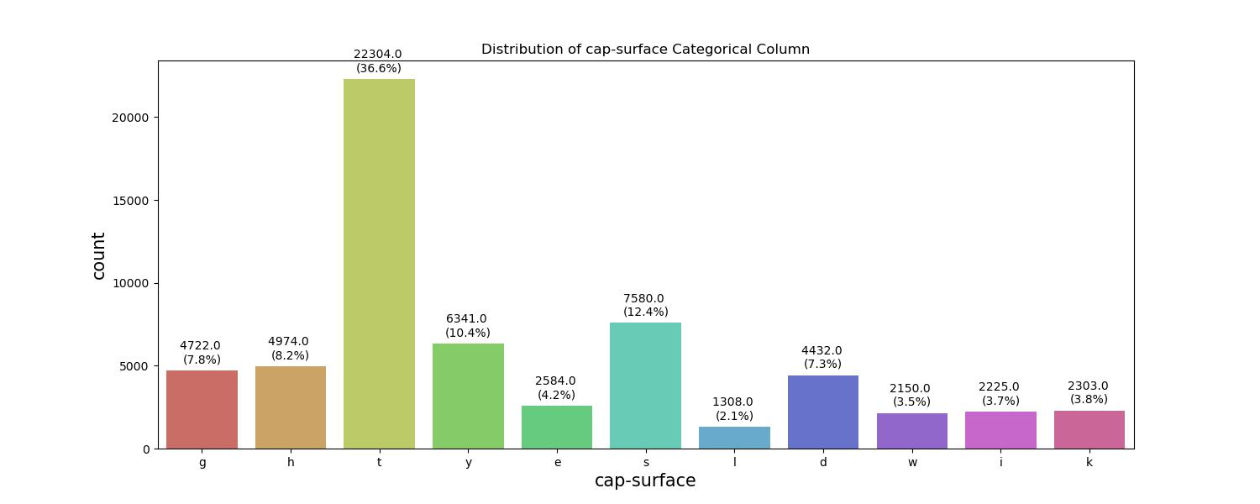
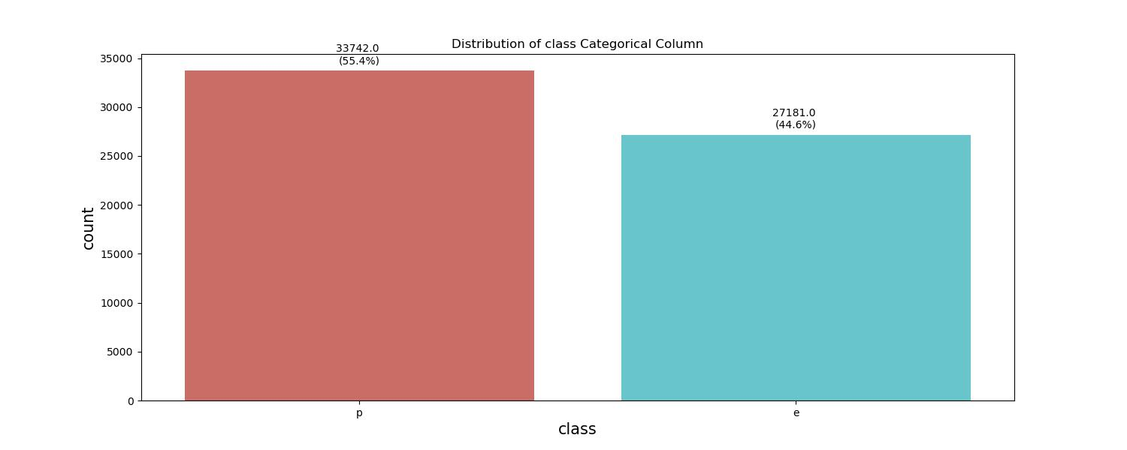
Univariate Analysis – Categorical Columns
Inference: All the Categorical columns have respectable proportion of count of unique values and most of columns have high cardinality.

Slide 8
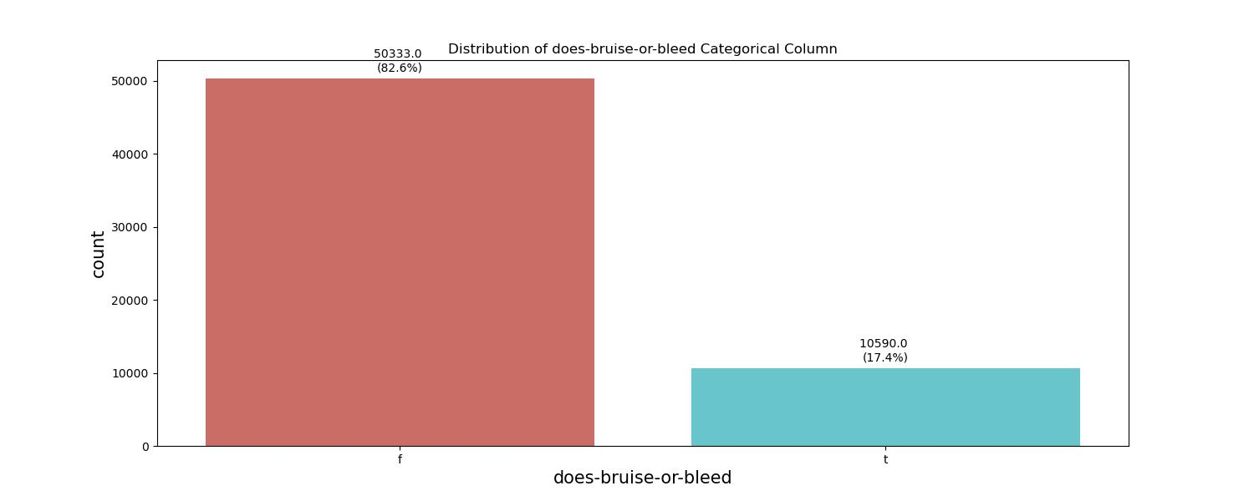
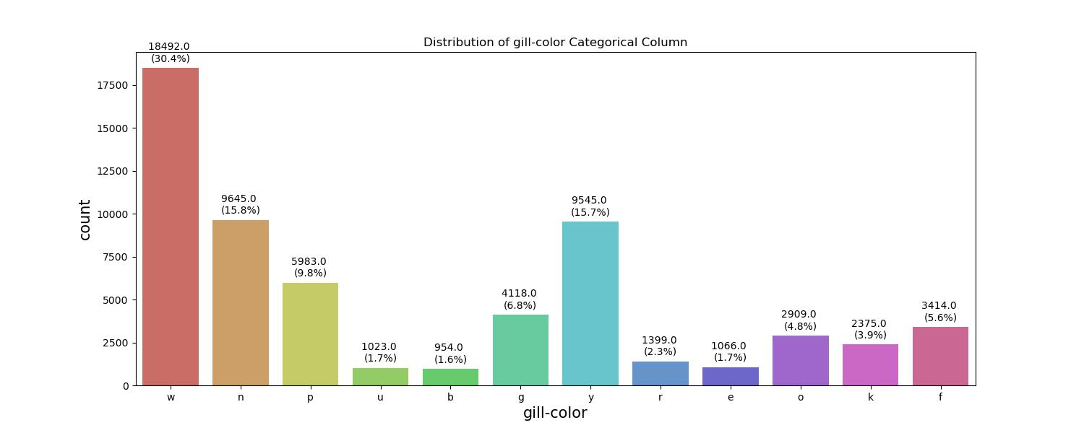
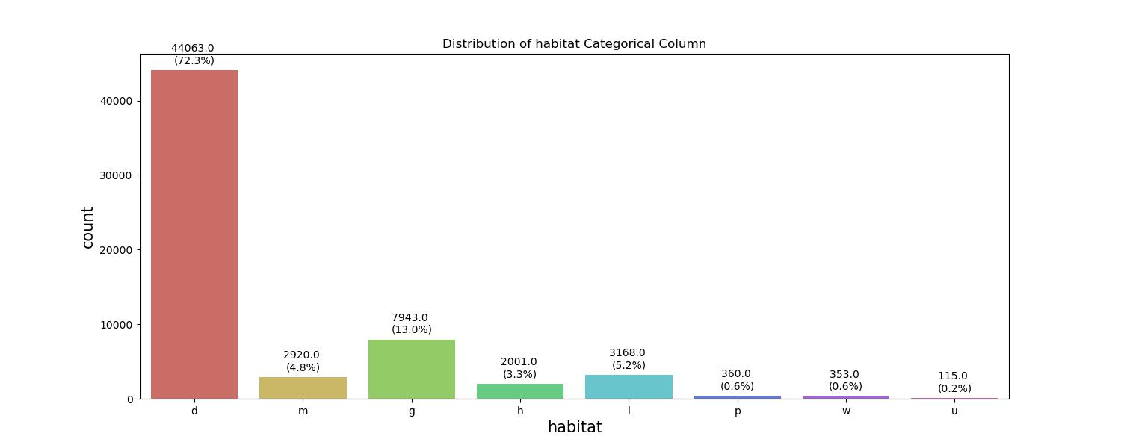
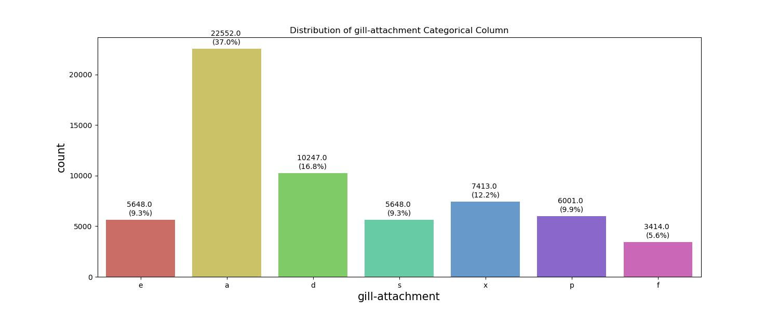
Inference: All the Categorical columns have respectable proportion of count of unique values and most of columns have high cardinality.

Slide 9
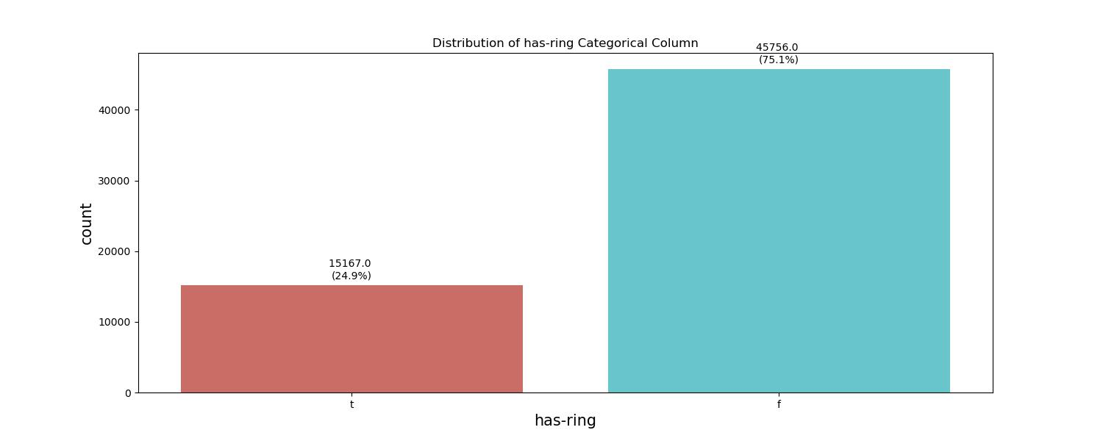
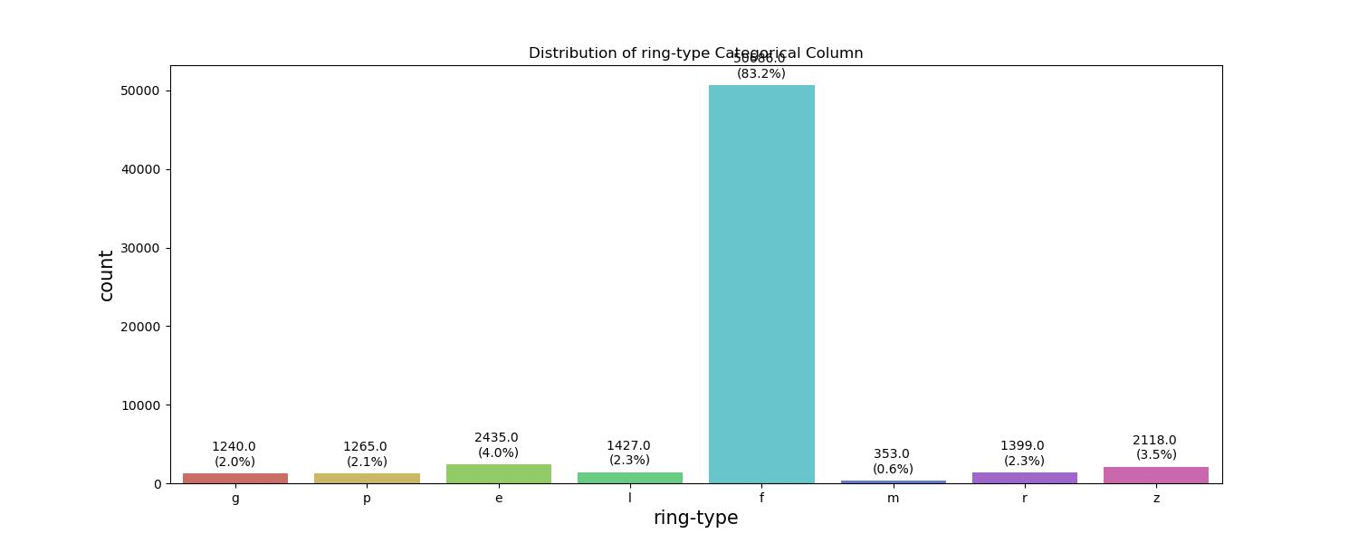
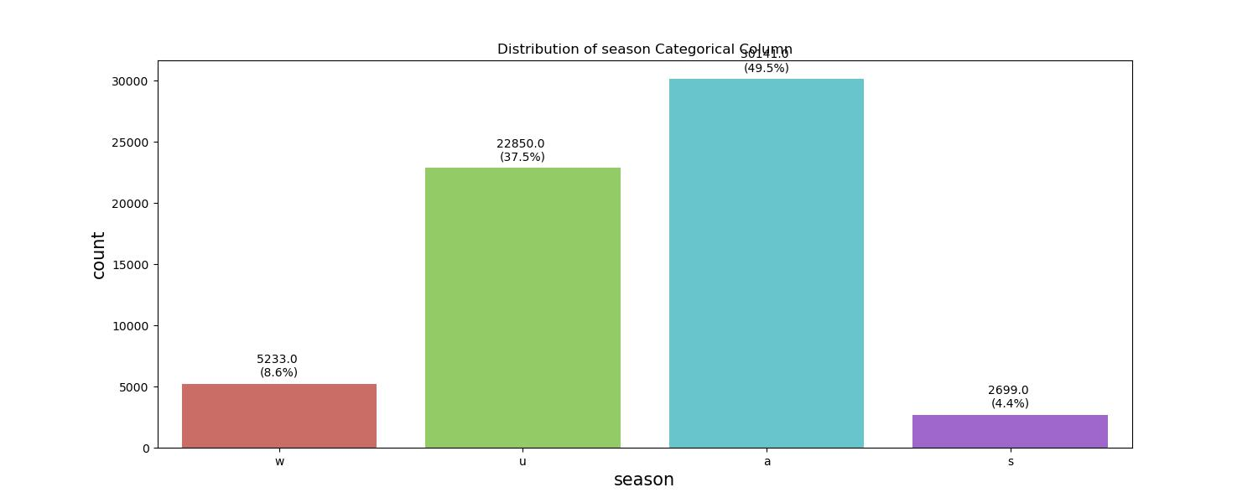
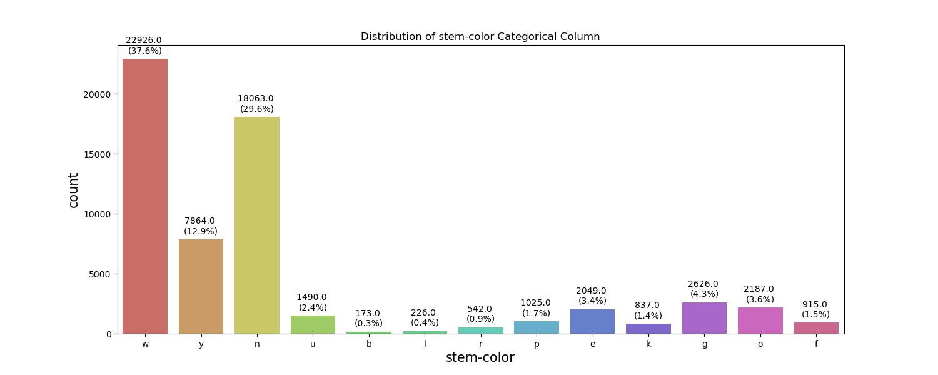
Inference: All the Categorical columns have respectable proportion of count of unique values and most of columns have high cardinality.

Slide 10
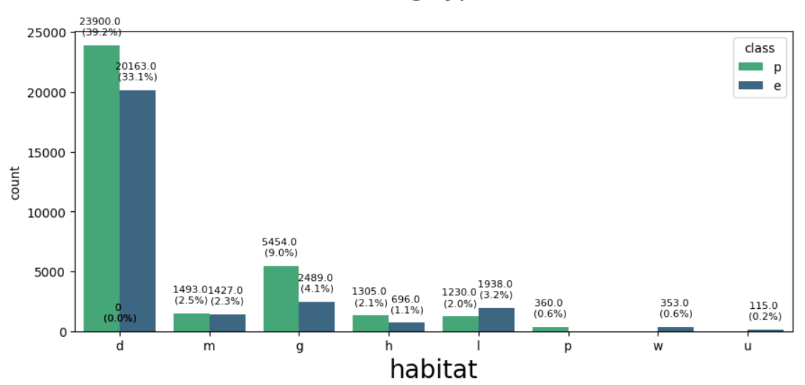
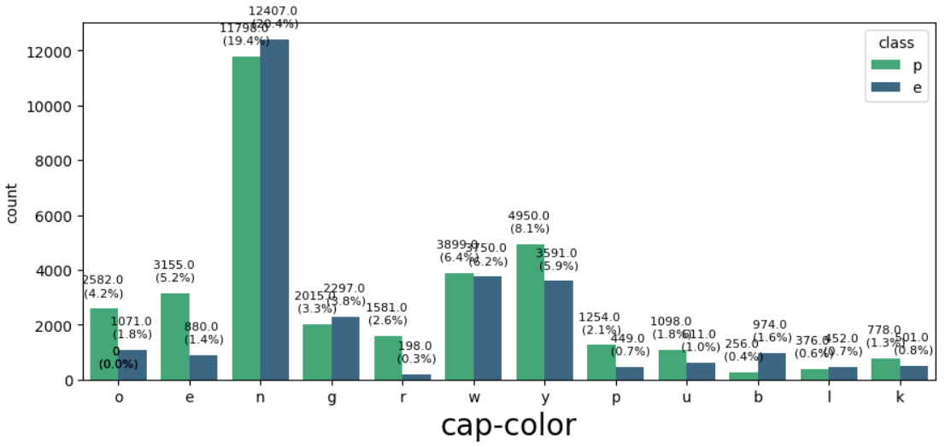
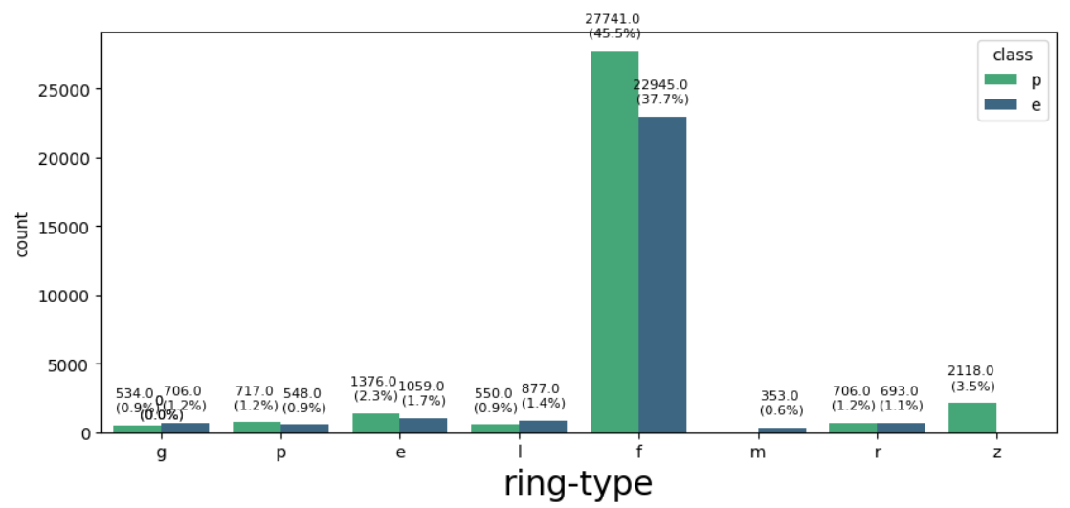
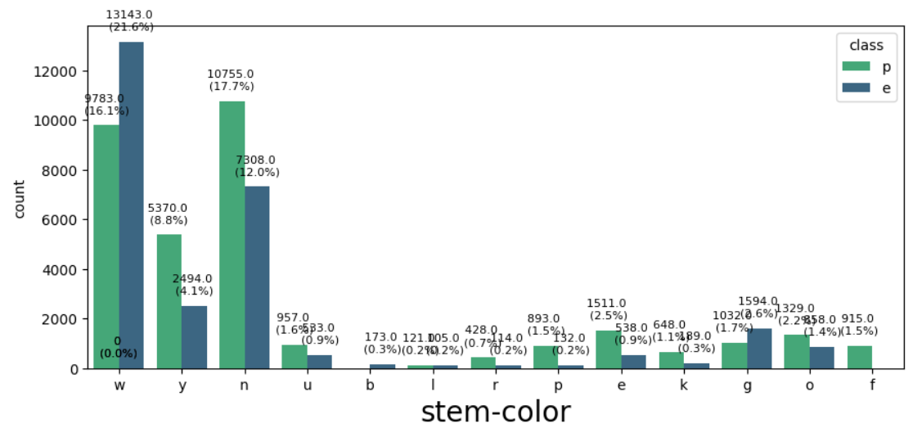
Inference - The Categorical has unique values in which smaller division also has approximate equal proportion of Edible and Poisonous, so we cant drop any column
EDA – Bivariate Analysis

Slide 11
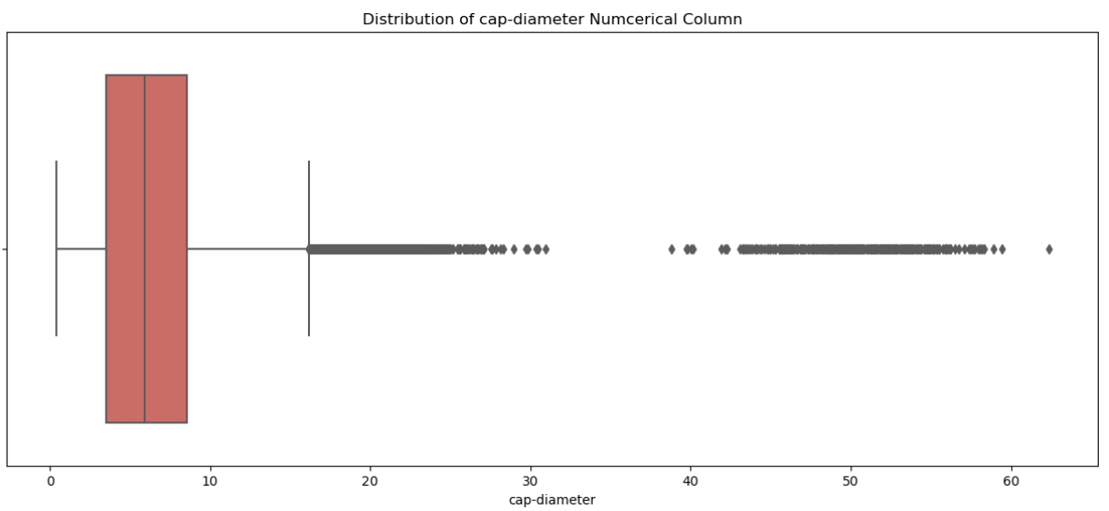
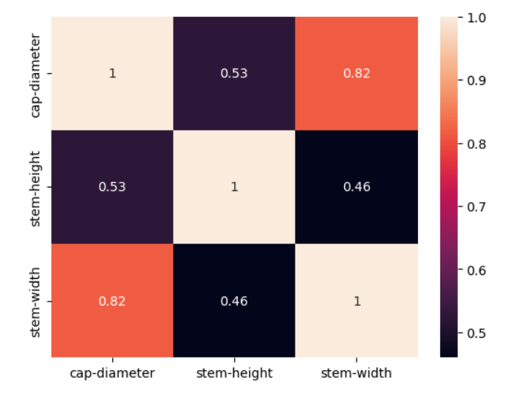
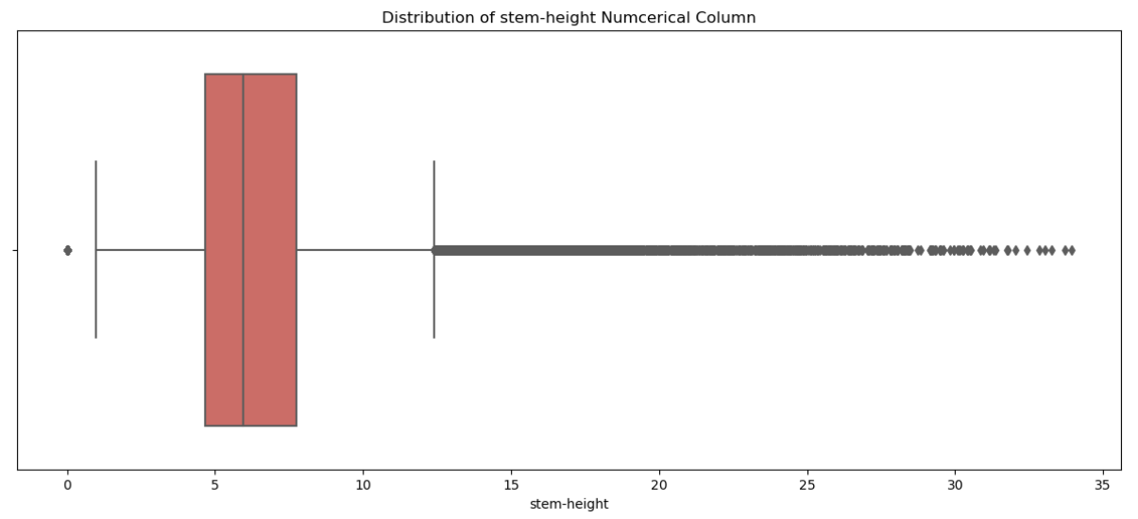
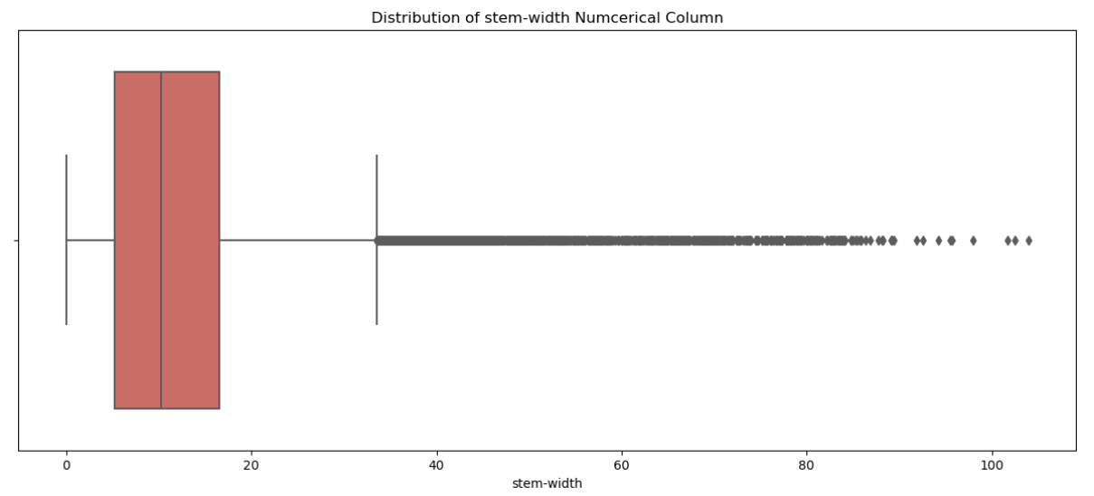
Analysis of Numerical Columns
Inference:
Numerical Columns have Outliers, Outliers should be treated by Box plot – IQR method
High Correlation between stem-width & cap-dia, therefore dropping one column

Slide 12
Processed and Cleaned Data
Y Train & Test
Poisonous -0
Edible - 1
X Train & Test
Hyperparameter Tuning – Grid Search
Pipeline
Processed Data
Splitting Data
Test size=70/30, Stratified
Encoding and Pipeline
Data Modelling
X_Train
Y_Train
P
Poisonous - 0
E
Edible - 1

Slide 13
Pipeline
Encoder
Binary Encoding – Has Added advantage over One Hot Encoding, decreases Sparsity and less number of columns comparatively
Frequency Encoding - replaces each category with the number of times it appears in the dataset
Scaler
Standard Scaler – Scales the features by Standardizing to ensure proper working of Distance Based Algorithms, ex: KNN
Classifier
Logistic Regression : LogisticRegression(random_state=42)
KNN : KNeighborsClassifier(metric='manhattan', n_neighbors= 5, weights= 'distance')
Decision Tree : DecisionTreeClassifier(criterion= 'entropy', max_depth= None, min_samples_split= 2,random_state=42)
Random Forest : RandomForestClassifier(max_depth= None, min_samples_split= 5, n_estimators= 50)
Naïve Bayes : GaussianNB()
XGB Classifier : XGBClassifier(learning_rate=0.2,max_depth= 7, n_estimators= 200, subsample= 1.0, random_state=42)
Hyperparameter Tuning using Grid Search CV

Slide 14
Code Flow
Code flow written
Loop over both encoders
Loop over classifiers
Pipeline – Take respective Encoder, Classifier – with Best Parameters
Cross Validation – on Training Data -> K – Folds = 5
Pipeline-Fit on (X-Train, Y-Train)
Pipeline-Predict on (X-Test)
Training Data
Cross Validation Metrics
Testing Data
Testing Metrics
Accuracy
Precision
Recall
F1 - Score

Slide 15
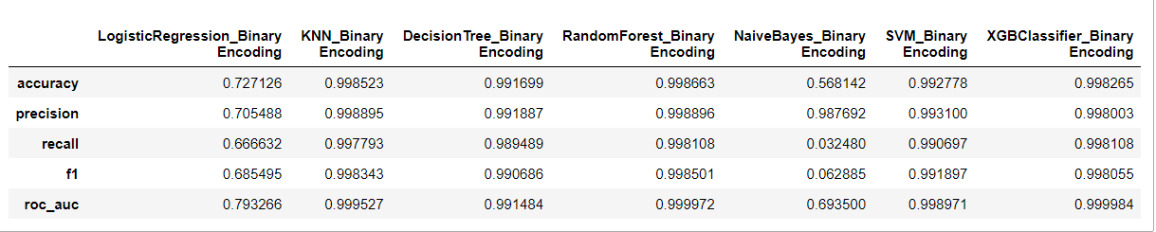
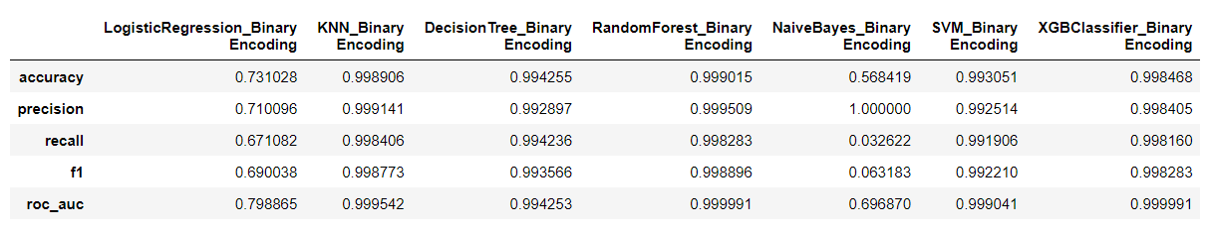
Train Prediction Metrics
KNN, Decision Tree, RF XGB has good and almost equal performance metrics. So any of these algorithm can be chosen given that algorithm should be memory and time efficient
Test Prediction Metrics

Slide 16
